Slide 1
Indexing Fundamentals
Steve Hood
SimpleSQLServer.com

Slide 2
The Rules
Interrupt me
Learn it as though you’ll teach it
Don’t leave without understanding

Slide 3
Outline
Index Types, focusing on clustered and nonclustered
How indexes are used and abused
The costs of clustered and nonclustered indexes
Cleaning up unwanted indexes
Links

Slide 4
Index Types
Heap (Not really an index)
Clustered
Nonclustered
XML
Spatial
Full-Text
Columnstore
Hash

Slide 5
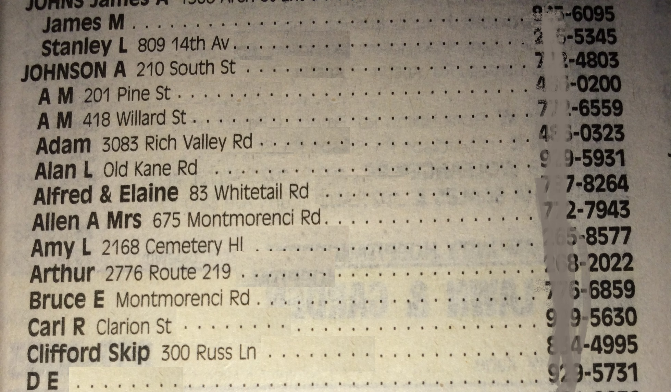
Clustered Index
Telephone book
Multiple keys
  Last Name
  First Name
  Middle Initial
  Address
  Phone Number

Slide 6
Heap
Reference book without a table of contents.
Has a page number
  It just happens to be in that order
Rare to have a legitimate use
  Very small tables, although it doesn’t enforce uniqueness
  Very large tables always referenced through other indexes
Significantly faster on inserts?
  This is a common myth

Slide 7
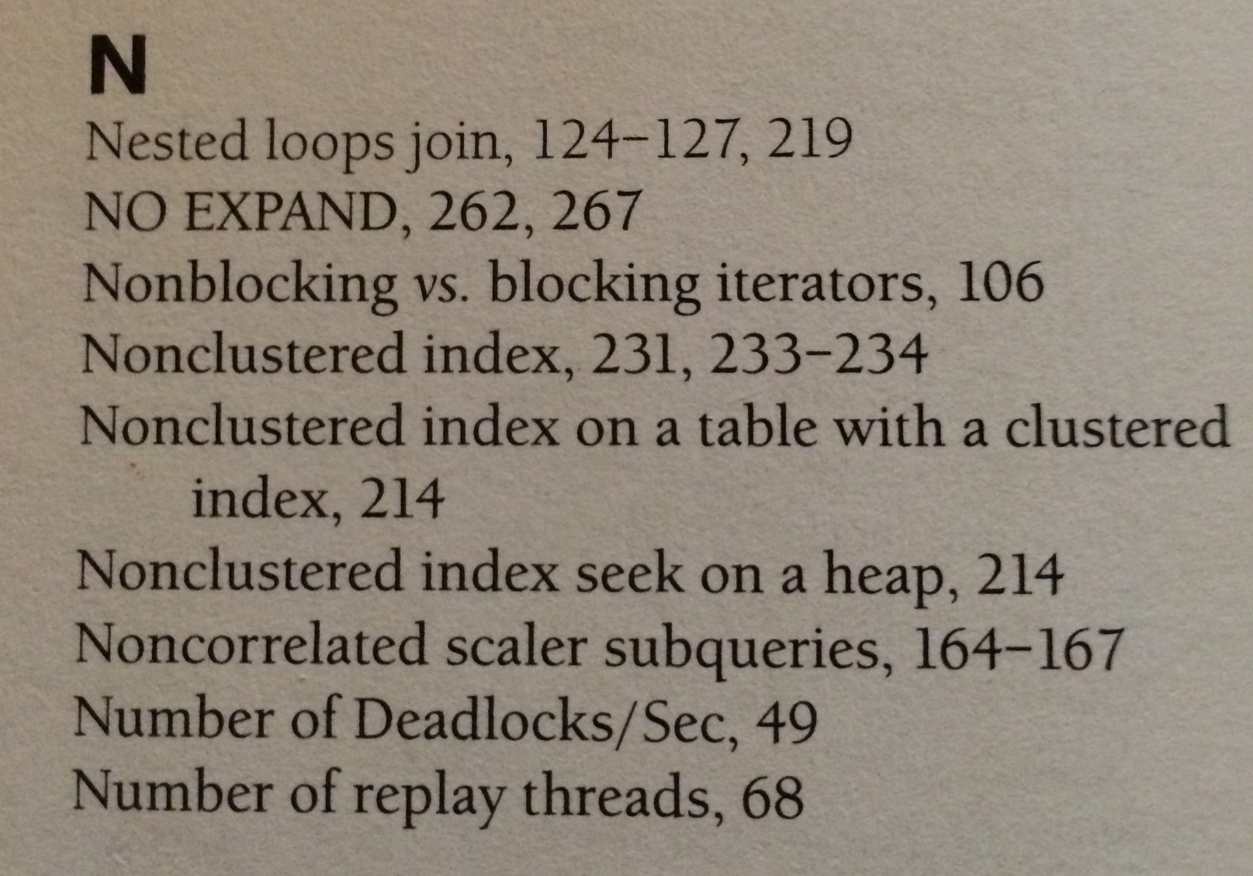
Nonclustered Index
Index at the back of a book
Example of a single key
with either RID
or Clustered Index Key

Slide 8
SARGable
SARGable = Search Argument capable
Bad: LastName LIKE '%Hoo%'
Good: LastName LIKE 'Hoo%'
Bad: Year(DateAdded) = @Year
Good: DateAdded >= Cast(Cast(@Year as VarChar(4)) + '-1-1' as DateTime) AND DateAdded < Cast(Cast(@Year + 1 as VarChar(4)) + '-1-1' as DateTime)
Bad: DateDiff(DAY, DateAdded, GetDate()) < 7
Good: DateAdded > DateAdd(DAY, -7, GetDate())

Slide 9
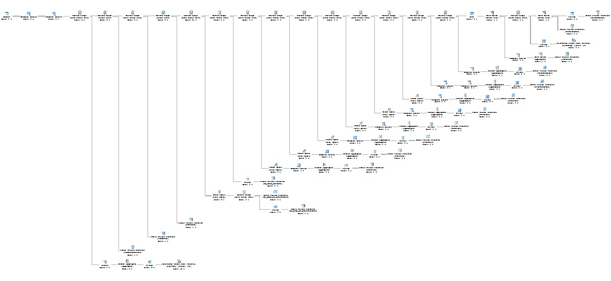
Execution Plans

Slide 10
Execution Plans
Do NOT look at the whole plan
SET STATISTICS TIME ON
SET STATISTICS IO ON
Indexes and Heaps are referenced in just three ways
  Scan
  Seek
  Lookup

Slide 11
Scan
Read every row in an index or heap
Not always a bad thing
  Using most or all records
Not always a good thing
  Non-SARGable arguments used
Lack of a Seek Predicate in an Execution Plan
Denny Cherry: Seeks Aren’t Always Better Than Scans
Rob Farley: Scans Are Better Than Seeks

Slide 12
Seek
Find rows in an index knowing at least part of the first key field
  Heaps don’t have key fields, so you can’t seek.
Typically more efficient
  Executing 1000 seeks can cost more than 1 scan (see links on last slide)
Does not mean it filtered it down much
Does not mean it didn’t scan through the rest of the records
  If there is a Predicate, there is at least one piece not handled by the key field(s)

Slide 13
Lookup
A nonclustered index was used, but didn’t have all the columns
  RID Lookup on Heaps
  Key Lookup on Clustered Indexes
Can be justified
  Less used query
  Large columns (especially XML, VarChar(Max), etc)
  Large number of columns

Slide 14
Covering Index
A single index that has every column requested by the statement
A clustered index includes every column
  Always a covering index
A nonclustered index can be by adding included columns
  Updates are more likely to need to update this index
  Index is larger
    Disk
    Backups
    Memory

Slide 15
Scan Demo
-- All demos are done on base install of AdventureWorks2008
--Also, all work on all supported versions of SQL Server
SET STATISTICS IO ON
SET STATISTICS TIME ON
--SARGable Scan and Seek
SELECT LastName, FirstName FROM Person.Person WHERE LastName LIKE '%simps%'
SELECT LastName, FirstName FROM Person.Person WHERE LastName LIKE 'simps%'

Slide 16
Seek Demo
SET STATISTICS IO ON
SET STATISTICS TIME ON
--Seek examples
--Didn't filter it down much
SELECT LastName, FirstName FROM Person.Person WHERE LastName LIKE '[a-m]%'
--Scanned through the rest of the records
SELECT LastName, FirstName FROM Person.Person WHERE LastName LIKE '[a-m]%' AND FirstName = 'Steve'

Slide 17
Lookup Demo
SET STATISTICS IO ON
SET STATISTICS TIME ON
--Lookup Examples
IF EXISTS (SELECT * FROM sys.indexes WHERE object_id = OBJECT_ID(N'[Person].[Person]') AND name = N'IX_Person_LastName_FirstName_MiddleName_INCL')
DROP INDEX [IX_Person_LastName_FirstName_MiddleName_INCL] ON [Person].[Person]
GO
--Able to do the same seek, but had to do a Lookup to get the EmailPromotion
SELECT LastName, FirstName, EmailPromotion FROM Person.Person WHERE LastName LIKE '[a-m]%' AND FirstName = 'Steve'

Slide 18
Covering Index Demo
--Covering Index Example
CREATE INDEX IX_Person_LastName_FirstName_MiddleName_INCL ON Person.Person
(
LastName
, FirstName
, MiddleName
)
INCLUDE
(
EmailPromotion
)
--Same select statement we used last time
SELECT LastName, FirstName, EmailPromotion FROM Person.Person WHERE LastName LIKE '[a-m]%' AND FirstName = 'Steve'

Slide 19
Filtered Index
Add a WHERE clause to an index declaration
Must match the WHERE clause in a query
Index on Orders WHERE status is “open”
  Will probably be less than 1% of the results
Index on Items WHERE QtyInStock > 0
Filtering by a common value that greatly reduces the number of rows
Must be filtered by static values
  Can’t do WHERE DateAdded > DateAdd(DAY, -7, GetDate())

Slide 20
Indexed Views
Require certain settings to be enabled by all connections editing data
Changes to all tables involved can update the view
  Gets to be expensive
Requires SCHEMABINDING on the view
They have their place
  Few updates compared to reads
    Or updates done in a specific window where you can drop the index and recreate it later
  Joining the tables takes a lot of resources
  Can be used for aggregations
Kendra Little wrote What You Can and Can’t Do With Indexed Views

Slide 21
Index Costs
Clustered – insignificant differences to heap
Nonclustered
  Data Modification Overhead
  Disk Space
  Backups Time and Size
  Memory

Slide 22
Memory Costs
SQL Server reads and writes data in memory
Writes ensure the page is in memory then updates it there
Reads ensure the page is in memory then uses it from there
SQL keeps data in memory as long as possible
  Page Life Expectancy shows how long it’s expected to hang around
  This reduces load on disk
  Less trips to disk mean better performance, even flash disks are slower
What is competing for your memory?
Cleaning Up the Buffer Pool to Increase PLE

Slide 23
Index Cleanup – Unused Indexes
Sys.dm_db_index_usage_stats
Make sure you trend over time
  Quarterly or annual reports
  DMV is reset on restart and can be reset on index maintenance
Indexes – Unused and Duplicates

Slide 24
Index Cleanup – Duplicate Indexes
Same first one or two key fields are typically considered duplicate
More costly than unused indexes
Can typically be combined
  More efficient even if new index is larger than any prior index
Indexes – Unused and Duplicates

Slide 25
Duplicate Indexes Demo
--Works best when run in prod, but it takes about 30 seconds of CPU to run in a descent environment
SELECT Cached_MB = Cast(x.cached_MB as DEC(20,1))
, ObjName = x.name
, x.index_id
, x.index_name
, Pct_Of_Total_Cache = cast((x.cached_mb * 100) / cast(SUM(x.cached_mb) over () as DEC(20,4)) as DEC(4,2))
, Pct_Of_Object_In_Cache = cast((x.cached_mb * 100) / cast(NULLIF(size.Used_MB,0) as DEC(30,4)) as DEC(10,2))
, Object_Size_MB = size.Used_MB
, Object_InRow_Size_MB = size.Used_InRow_MB
, Object_LOB_Size_MB = size.Used_LOB_MB
, free_space_mb
, dirty_pages_mb
FROM (
SELECT count(1)/128.0 AS cached_MB
, name = OBJECT_SCHEMA_NAME(p.object_id) + '.' + object_name(p.object_id)
, p.object_id
, p.index_id
, index_name = i.name
, free_space_mb = CAST(SUM(bd.free_space_in_bytes)/1024/1024.0 as DEC(20,1))
, dirty_pages_mb = CAST(SUM(cast(is_modified as Int))/128.0 as DEC(20,1))
FROM sys.dm_os_buffer_descriptors AS bd with (NOLOCK)
INNER JOIN sys.allocation_units AS au with (NOLOCK) ON bd.allocation_unit_id = au.allocation_unit_id
INNER JOIN sys.partitions AS p with (NOLOCK) ON (au.container_id = p.hobt_id AND au.type IN (1,3))
OR (au.container_id = p.partition_id AND au.type = 2)
INNER JOIN sys.indexes i ON p.object_id = i.object_id AND p.index_id = i.index_id
WHERE database_id = db_id()
GROUP BY p.object_id, p.index_id, i.name
--HAVING Count(1) > 128
) x
INNER JOIN
(
SELECT PS.object_id
, PS.index_id
, Used_MB = Cast(SUM(PS.used_page_count) / 128.0 as DEC(20,2))
, Used_InRow_MB = Cast(SUM(PS.in_row_used_page_count) / 128.0 as DEC(20,2))
, Used_LOB_MB = Cast(SUM(PS.lob_used_page_count) / 128.0 as DEC(20,2))
FROM sys.dm_db_partition_stats PS
GROUP BY PS.Object_ID, PS.Index_ID
) size ON x.object_id = size.object_id AND x.index_id = size.index_id
ORDER BY 5 DESC, 1 DESC;

Slide 26
Data Compression – At a Glance
Enterprise-Only feature
Row and Page Compression
  Page is Row Compression + more
  B+Tree has Row Compression
Uses more CPU because it uncompresses as it’s being used
Uses less memory because it’s compressed in memory, too
Uses less CPU and Disk IO for physical reads
  Less to read from disk
  Less data in memory, less memory pressure, lower data turnover
Different data compresses at different rates (sp_estimate_data_compression_savings)

Slide 27
Posts I wrote for more info
Fixing Page Life Expectancy (PLE)
Cleaning Up the Buffer Pool to Increase PLE
Indexing Fundamentals
Optional Parameters Causing Index Scans
Indexes – Unused and Duplicates

